Slide 1
SEC555
Presentation based on SEC555: SIEM with Tactical Analytics
Got Sysmon? How to Deploy Sysmon and Collect the Logs in an Enterprise Environment
Scott Lynch, SEC555 Instructor
@PacketEngineer

Slide 2
About Me
Instructor SEC555: SIEM with Tactical Analytics
Global Manger Security Operations, Global Satellite Communications Company
GIAC GCDA, GDSA, GNFA, GCIH, Cisco CCNP-S, Cisco Instructor
Navy Veteran, CVN EW

Slide 3
Welcome!
A copy of this talk is available at: https://github.com/scottl1736/presentations
LinkedIn and Twitter: @packetengineer

Slide 4
Goal of this Webcast
Increase visibility and reaction time
Discuss the benefits of collecting windows logs
Add additional logging capabilities to your endpoints
Forward logs via agent or WEF

Slide 5

Logs
Many organizations don’t collect, store nor analyze the logs within their environments

Slide 6
Asset Management
Cant log what you don’t know about…
“CIS #1 Inventory of Authorized and Unauthorized Devices”
“CIS #2 Inventory of Authorized and Unauthorized Software”

Slide 7

Centralized Logging, The Holy Grail
Security Monitoring and Alerting
Health and Management
Compliance
Forensics and Incident Response
Teamwork

Slide 8

Windows Default Logs
Helpful but could be better
Some are disabled by default
PowerShell Logging
Command Line Process Auditing
Can we make it better?

Slide 9
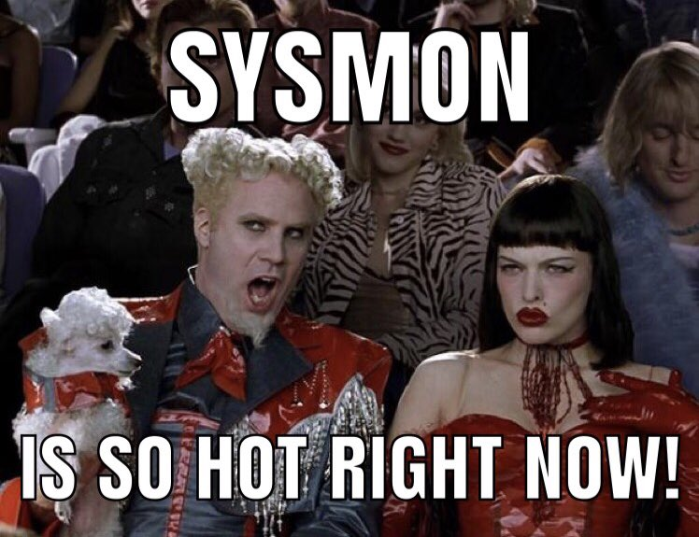
Sysinternals Sysmon
Developed Mark Russinovich and Team at Microsoft
Additional windows logging channel
Security and forensic value add
Extends windows logging capabilities
https://docs.microsoft.com/en-us/sysinternals/downloads/sysmon

Slide 10
Sysmon Features
Process creation with full command line
Hash of process image files using SHA1 (the default), MD5, SHA256 or IMPHASH.
Includes a process GUID in process create
Include a session GUID in each events
Logs loading of drivers or DLLs with their signatures and hashes.
Logs opens for raw read access of disks and volumes
Logs network connections, including each connection’s source process, IP addresses, port numbers, hostnames and port names
Detects changes in file creation time
Rule filtering to include or exclude certain events
Generates events from early in the boot process to capture activity made by even sophisticated kernel-mode malware

Slide 11
Sysmon Event ID’s
Event ID 1: Process creation
Event ID 2: A process changed a file creation time
Event ID 3: Network connection
Event ID 4: Sysmon service state changed
Event ID 5: Process terminated
Event ID 6: Driver loaded
Event ID 7: Image loaded
Event ID 8: CreateRemoteThread
Event ID 9: RawAccessRead
Event ID 10: ProcessAccess
Event ID 11: FileCreate
Event ID 12: RegistryEvent (Object create and delete)
Event ID 13: RegistryEvent (Value Set)
Event ID 14: RegistryEvent (Key and Value Rename)
Event ID 15: FileCreateStreamHash
Event ID 17: PipeEvent (Pipe Created)
Event ID 18: PipeEvent (Pipe Connected)
Event ID 19: WmiEvent (WmiEventFilter activity detected)
Event ID 20: WmiEvent (WmiEventConsumer activity detected)
Event ID 21: WmiEvent (WmiEventConsumerToFilter activity detected)
Event ID 22: DNSEvent (DNS query)
Event ID 255: Error

Slide 12
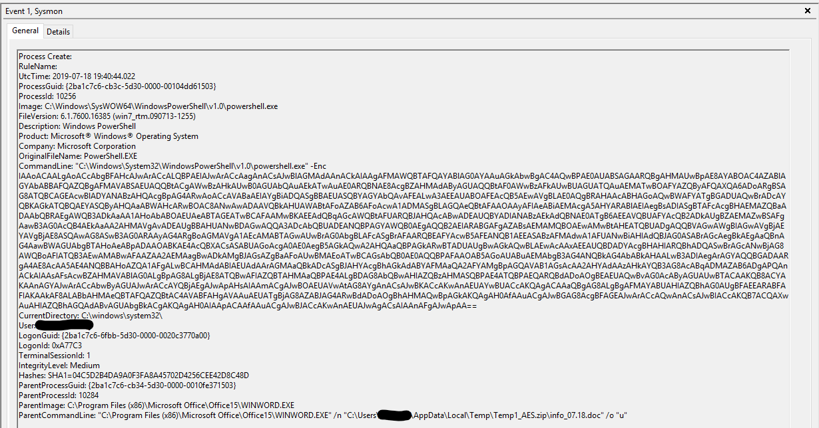
Sysmon Catching PowerShell Base64 Encoded String
Sysmon caught this!

Slide 13
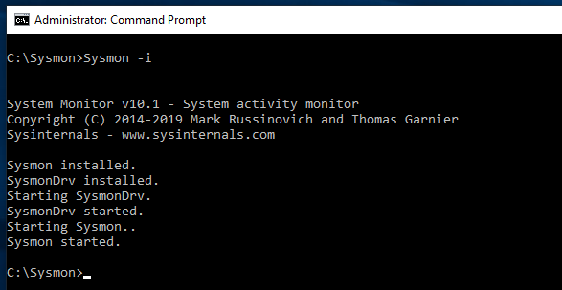
Installation
Straight forward install process
sysmon -accepteula –I
Install with default settings
Install: Sysmon.exe -i <configfile> [-h <[sha1|md5|sha256|imphash|*],...>] [-n [<process,...>]] [-l (<process,...>)]
https://docs.microsoft.com/en-us/sysinternals/downloads/sysmon

Slide 14
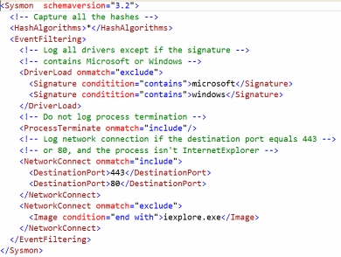
Default Sysmon Config
XML based
Flexible
Many filtering options

Slide 15
Additional Configuration Options
SwiftOnSecurity https://github.com/SwiftOnSecurity/sysmon-config
Olaf Hartong
https://github.com/olafhartong/sysmon-modular
Sysmon Community Guide by Carlos Perez TrustedSec LLC
https://github.com/trustedsec/SysmonCommunityGuide

Slide 16
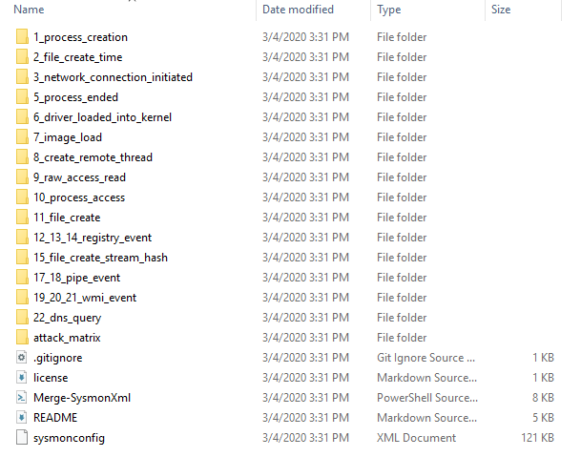
Modular Sysmon Config
Developed by Olaf Hartong
https://github.com/olafhartong/sysmon-modular
Modular = easier to maintain
Choose your own adventure
Maps in MITRE Techniques from the ATT&C Framework

Slide 17
Sysmon Deployment Options
Manual Install
Download and install on each endpoint
Automated Deployment and Install
GPO and Scheduled Task
Third Party Tools
https://www.syspanda.com/index.php/2017/02/28/deploying-sysmon-through-gpo/
https://github.com/jokezone/Update-Sysmon

Slide 18
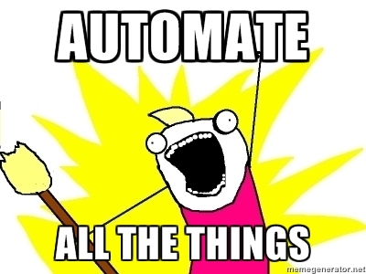
Sysmon Deployment Options – Cont.
Deployment tools
SCCM
Lansweeper
PowerShell
Ansible
And many more…

Slide 19
Log Collection
Windows Event Forwarding (WEF)
NSA Spotting the Adversary
End Point Agents
Winlogbeat
Nxlog
Universal Forwarder

Slide 20


Choose Your Own Adventure
If you can support agents, use them!
Support additional features not found in WEF
If you cant deploy agents than use WEF (still an agent )

Slide 21
Additional Resources
SwiftOnSecurity @SwiftOnSecurity
Olaf Hartong @olafhartong
Pablo D. @PabloSyspanda
Roberto Rodriguez @Cyb3rWard0g
Carlos Perez @Carlos_Perez
Nate Guagenti @neu5ron
And many many more….
Peerlyst https://www.peerlyst.com/
Medium https://medium.com/
Eric Conrad Threat hunting with Sysmon https://www.youtube.com/watch?v=7dEfKn70HCI

Slide 22

Summary
How to Deploy Sysmon and Collect the Logs
Plan your deployment
Deploy log enhancements and agents
Collect the logs
Consider SEC555: SIEM with Tactical Analytics
Rumor is… There may also be a new course soon:
Tactical Data Handling at Scale with Logstash

